Slide 1
Kubernetes for developers session 3

Slide 2
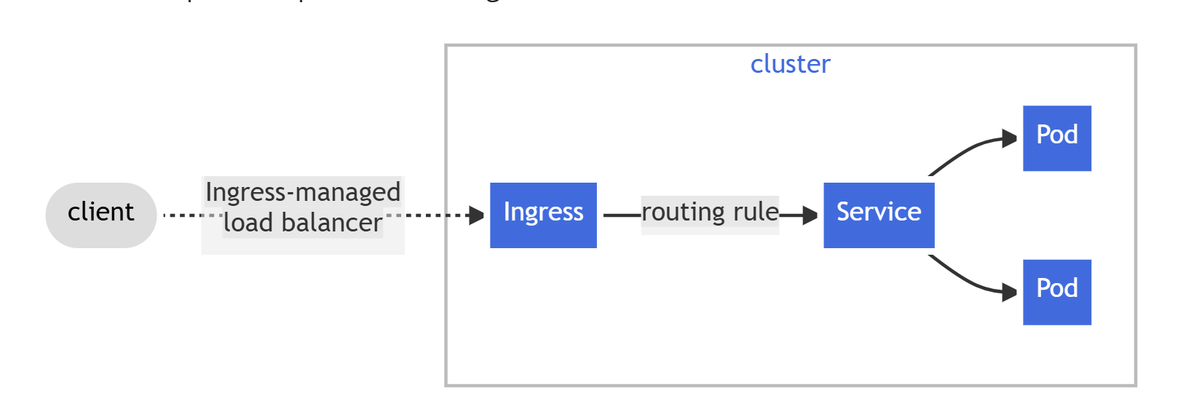
Ingress
Make your HTTP (or HTTPS) network service available using a protocol-aware configuration mechanism, that understands web concepts like URIs, hostnames, paths, and more. The Ingress concept lets you map traffic to different backends based on rules you define via the Kubernetes API.
This controller need to be installed on the cluster!

Slide 3
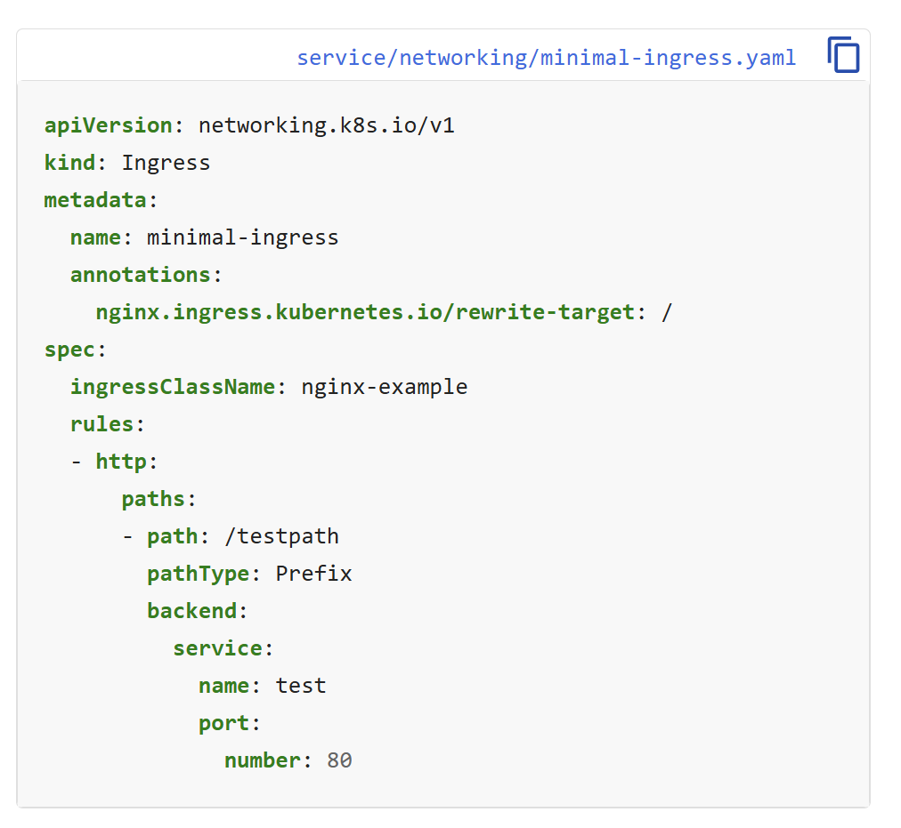
Example
rewrites path in to pod from
/testpath to /, because nginx responds at /
needs to match class of installed ingress controller
incomming request needs to match this pattern
service and port to route to

Slide 4
Azure has an ingress addon
The addon will simplify the installation of the ingress controller
The addon will install and configure a nginx LoadBalancer
We need to use the correct classname in ingress to use the LoadBalancer installed:
ingressClassName: webapprouting.kubernetes.azure.com

Slide 5
Lets see it in action
We will create an ingress following the guide here:
https://learn.microsoft.com/en-us/azure/aks/app-routing
1. Look at the files here: https://raw.githubusercontent.com/Azure-Samples/aks-store-demo/main/sample-manifests/docs/app-routing/aks-store-deployments-and-services.yaml
2. Apply the files and check status of deployments (kubectl get/describe deploy)
3. The deployments are expose with clusterIP, now we want to acess it using kubernetes ingress
4. Apply the ingress example and se if you can access the store-front app using path based approach.

Slide 6
Pod configurations
Now that we know how to access pods, lets look at some more configurations.
We will look at how we can set environment variables from configmaps/secrets to configure our app.
We will look at how to mount volumes in an app for permanent storage

Slide 7
Configmaps from-literals

Slide 8
Using env and envFrom in Pod

Slide 9
Secrets are similar but base64 encoded
You can convert it manually when creating from yaml file
echo -n 'Hello world' | base64
Same command as configmaps when created and very similar when mounting in pod.

Slide 10
Pods are stateless but…
Some containers require files to be stored on disk
Sometimes we need to cache data in some directory
Once a pod has restarted, all data is lost
Small files can be mounted in configmaps
Larger files should be stored in PersistentVolumes
To claim data from a persistentVolume we need to define a persistenVolumeClaim

Slide 11
Simple cache volume
The cache volume will store everything inside /cache in the test-container
emptyDir can be used to create a temporary storage

Slide 12
PersistentVolume
Set an optional classname if defined in cluster.
Set a requested storage amount
Set accessMode

Slide 13
PersistentVolumeClaim
If any peristenVolume has a matching classname it can be used.
Needs to match persistentVolume accessType
Amount of storage, needs to be less then available on persistentVolume

Slide 14
Creating a volume inside a pod from a persistentVolumeClaim
Needs to match the name of an existing claim.
Volume name and Mount name needs to match.

Slide 15
Challenge setup postgres in Kubernetes.
Follow the instruction in the zip fil.
and se if you can setup postgresql in kubernetes, with a secret and volume (for storage between restarts)
Guidelines:
use kubectl get/describe to look at status for all created resources (-o=yaml flag for yaml output)
use kubectl logs deploy/postgres to check logs inside postgres
create -f myFile.yaml to create a k8s resource
use create commands from documentation to create without yaml
use use kubectl exec -it deploy/postgres -- sh , to start a shell inside the postgres pod if you want to check filesystem and env. (You can run the env command to check all env set from secret)
Usually we can steal yaml files from k8s documentation and the modify them as a base
If you want to, you can use port-forwarding on the service to connect to the postgres database

